Slide 1
POST-FIRE HYDROLOGIC HAZARDS & MITIGATION STRATEGIES for Communities in Colorado
Colorado Intergovernmental Risk Sharing Agency
Discussion Panel
Andrew Earles, Ph.D., P.E., CPESC
Natalie Collar, CFM, HIT
Wayne Lorenz, P.E.
Wright Water Engineers, Inc.

Slide 2
Post-fire Hydrologic Hazards & Values at Risk

Slide 3
POST-FIRE HAZARDS & VARs
MITIGATION
WARNING & EVACUATION

Slide 4
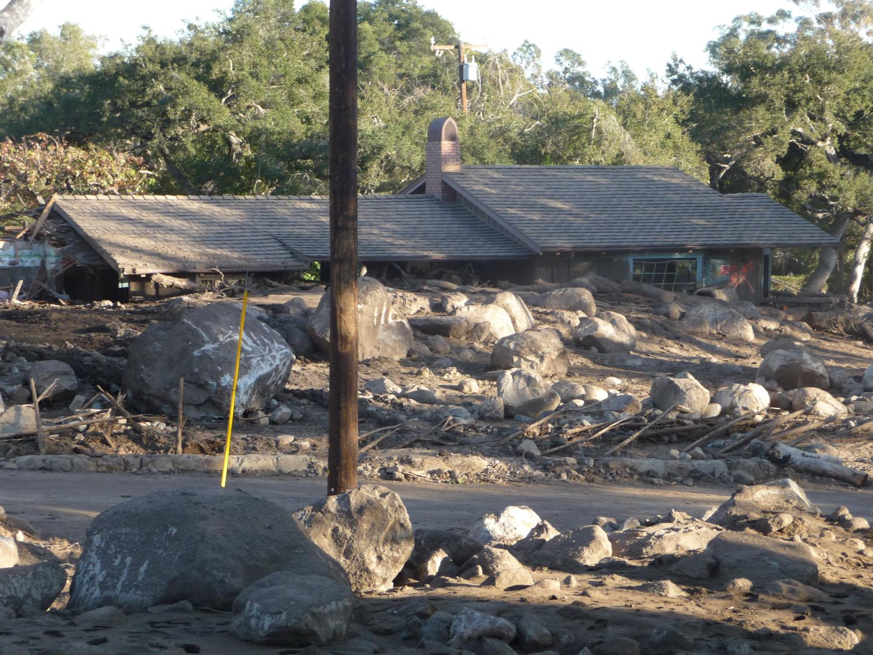
Impacts to structures
POST-FIRE HAZARDS & VARs
MITIGATION
WARNING & EVACUATION
Structures at Risk
Anything on an alluvial fan
Near mapped and unmapped floodplains
Constructed prior to modern floodplain and building requirements
At the toe of steep slopes
In or downgradient of mapped landslides
In roadway overtopping flow paths
Rebuilding during recovery period

Slide 5
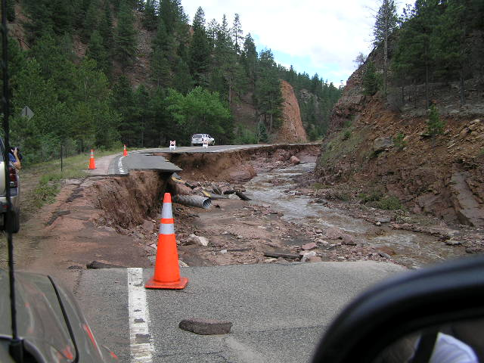
Photo Credit: B. Jarrett, USGS

Slide 6
Risks to water infrastructure
POST-FIRE HAZARDS & VARs
MITIGATION
WARNING & EVACUATION
About 32% of the 500 water
samples [in Paradise, CA] detected benzene at an average level of 27 parts per billion (ppb).
California's drinking water standard is one ppb; the federal standard is five ppb.

Slide 7
Mitigation Strategies

Slide 8
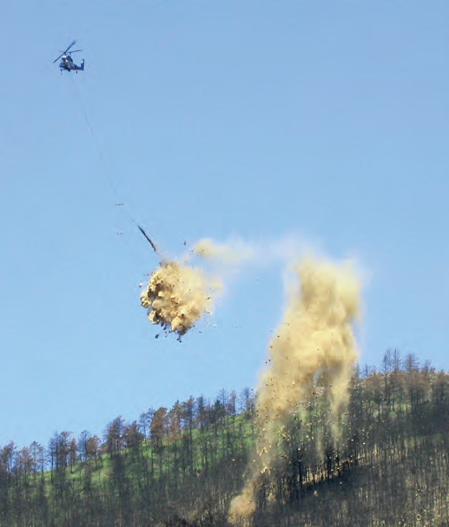
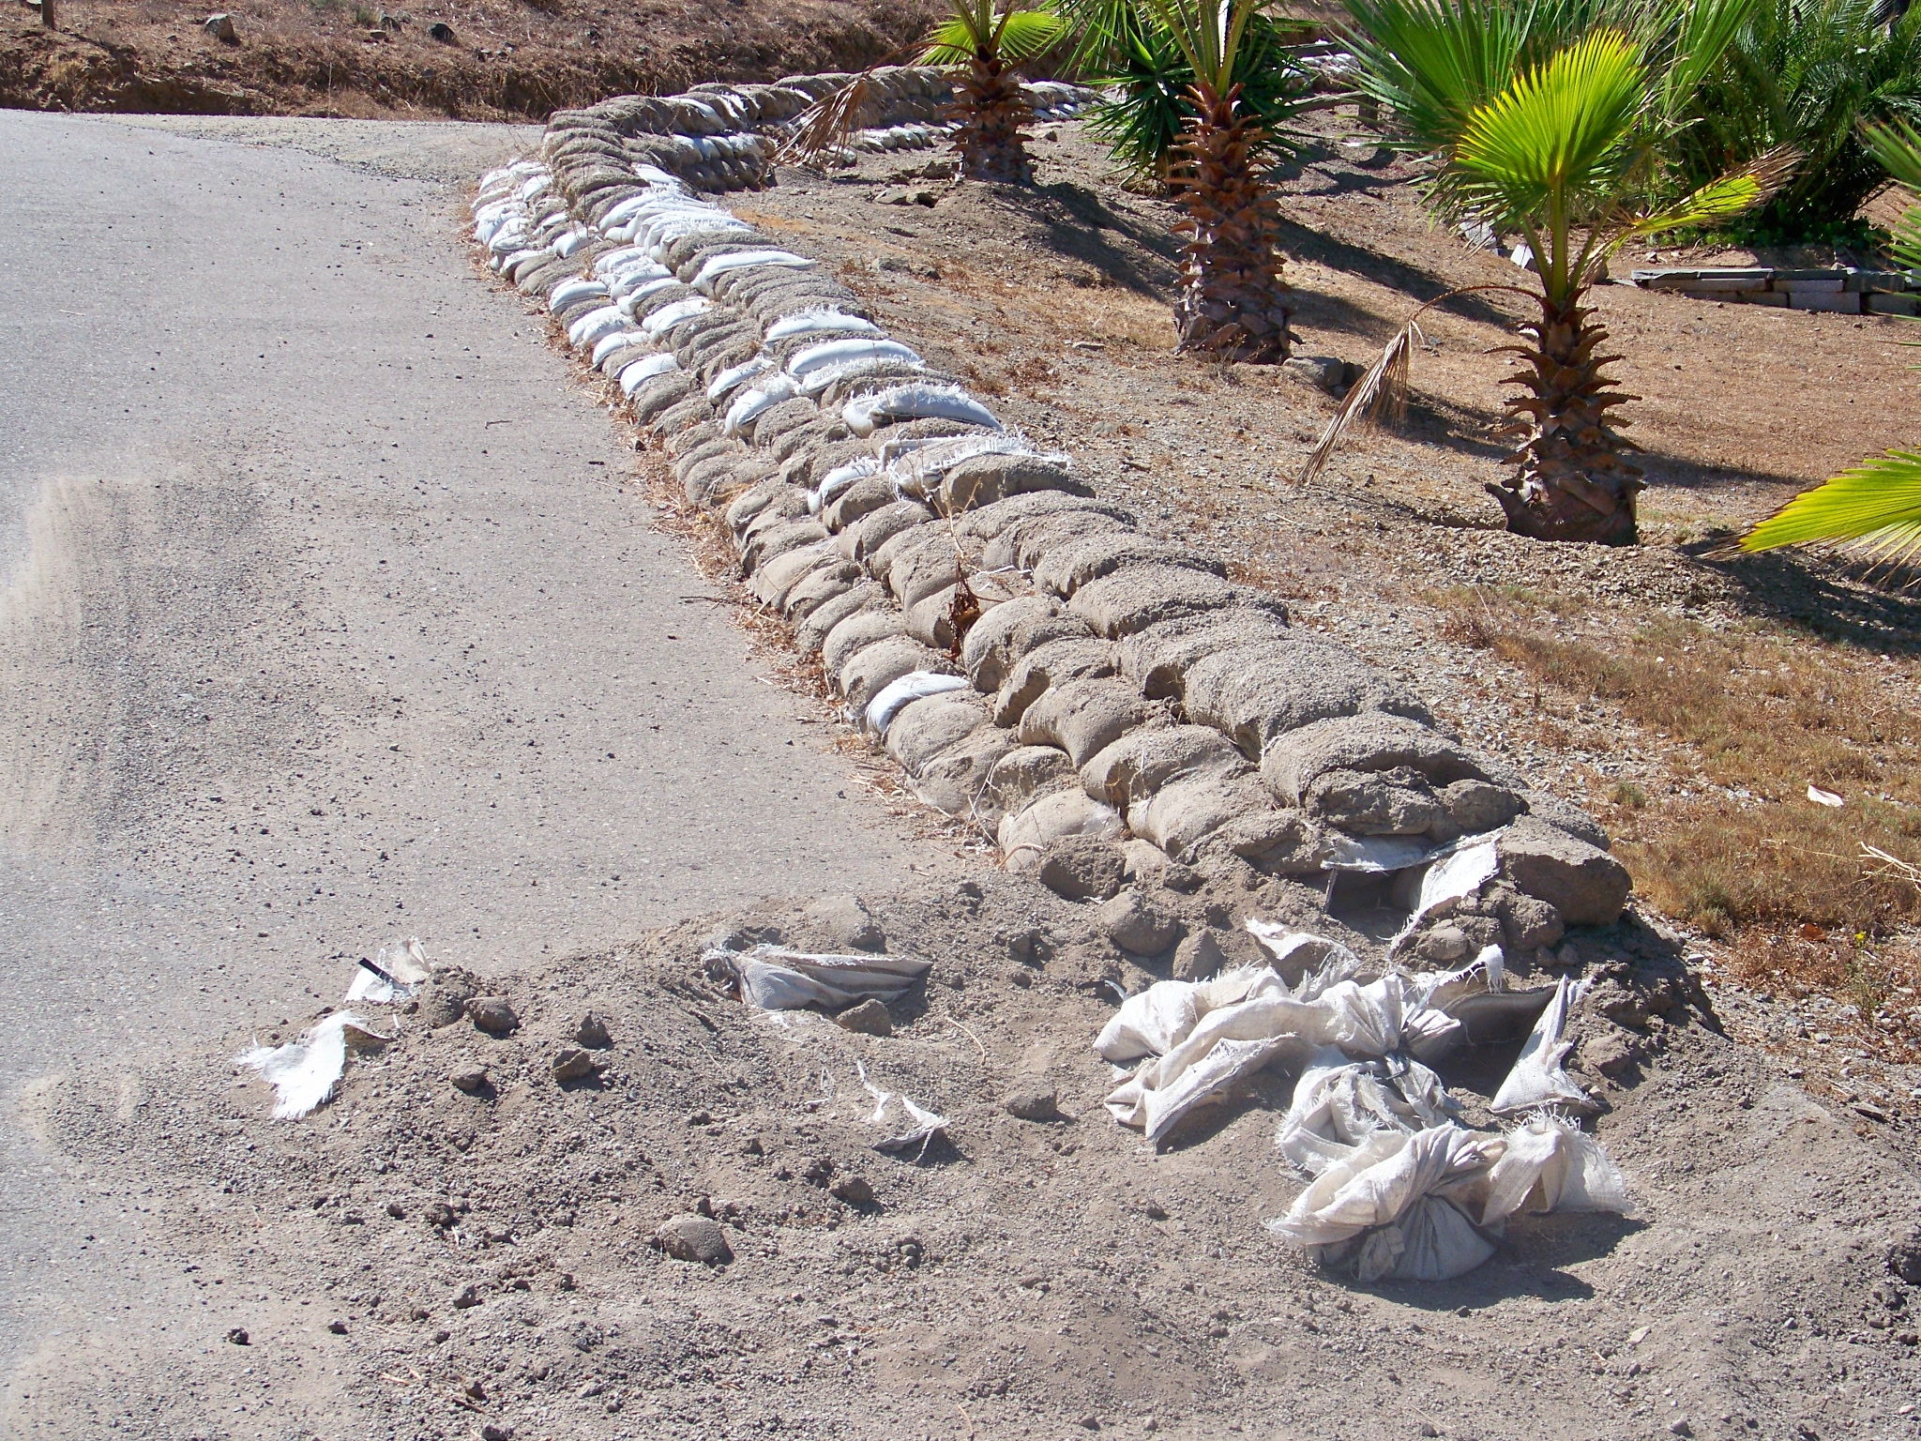
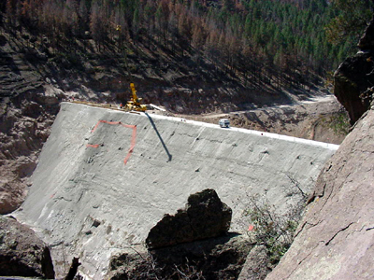
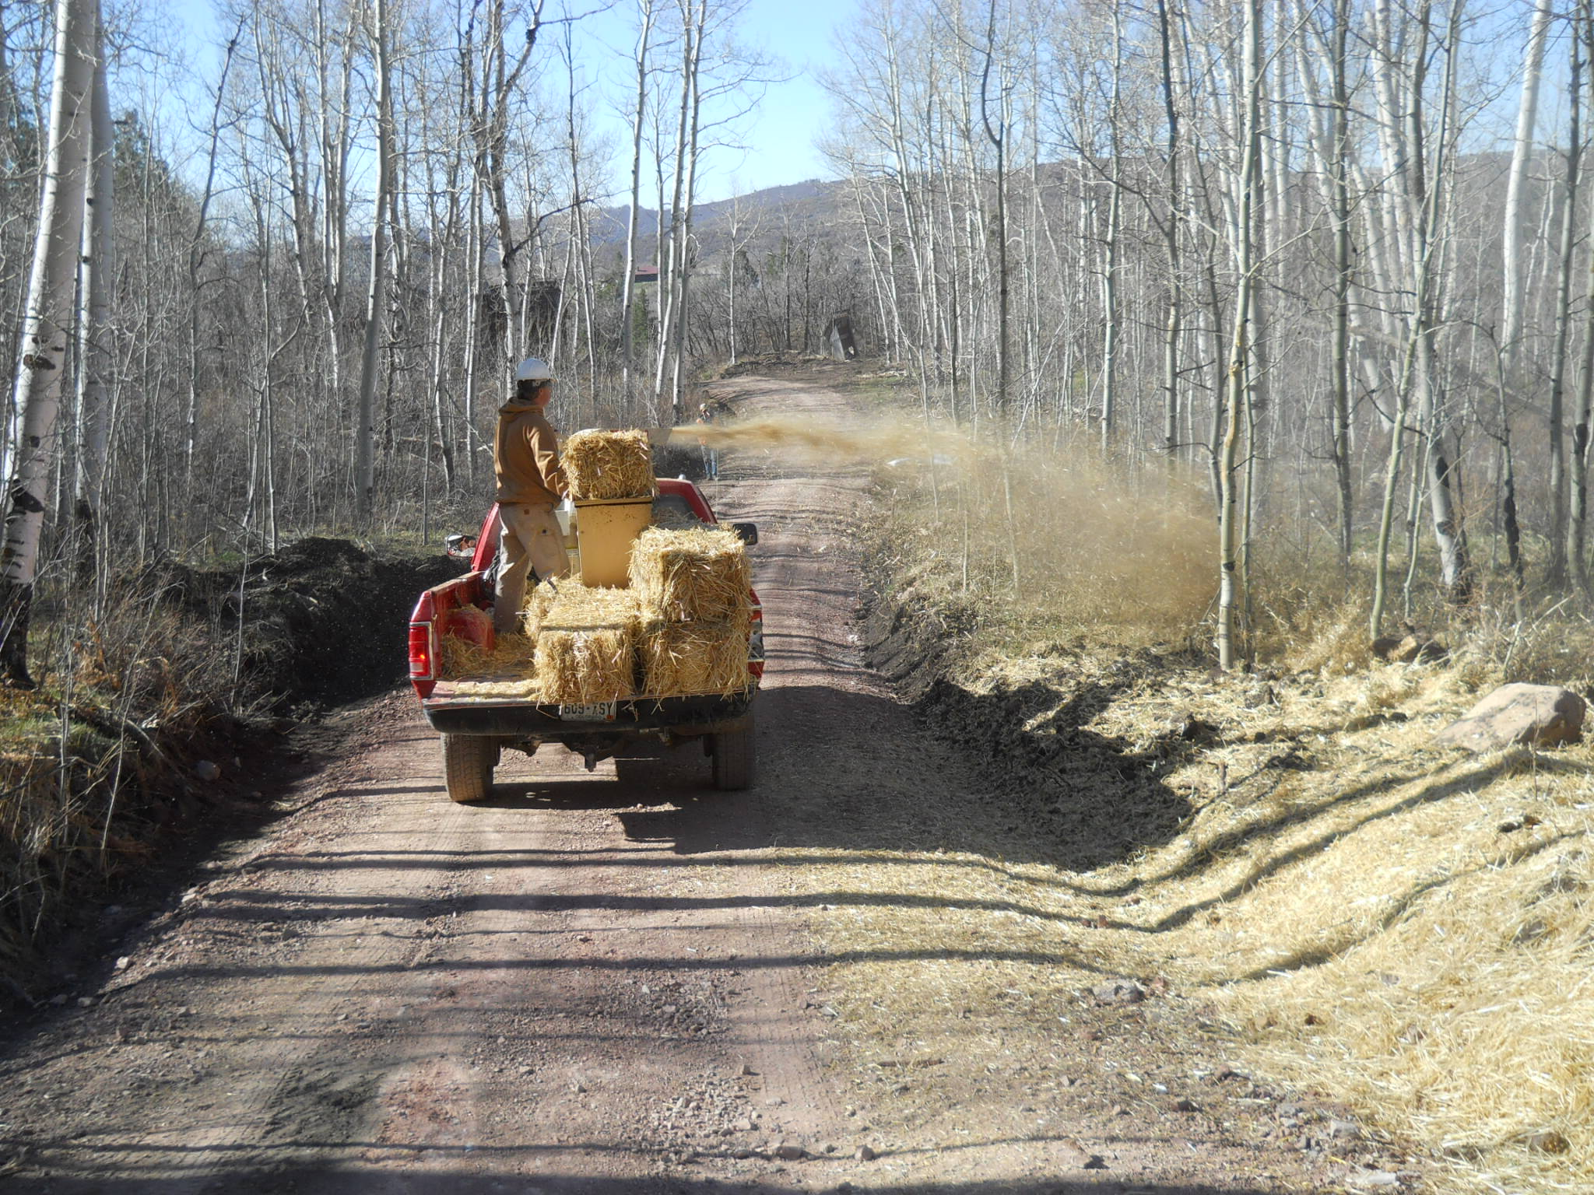
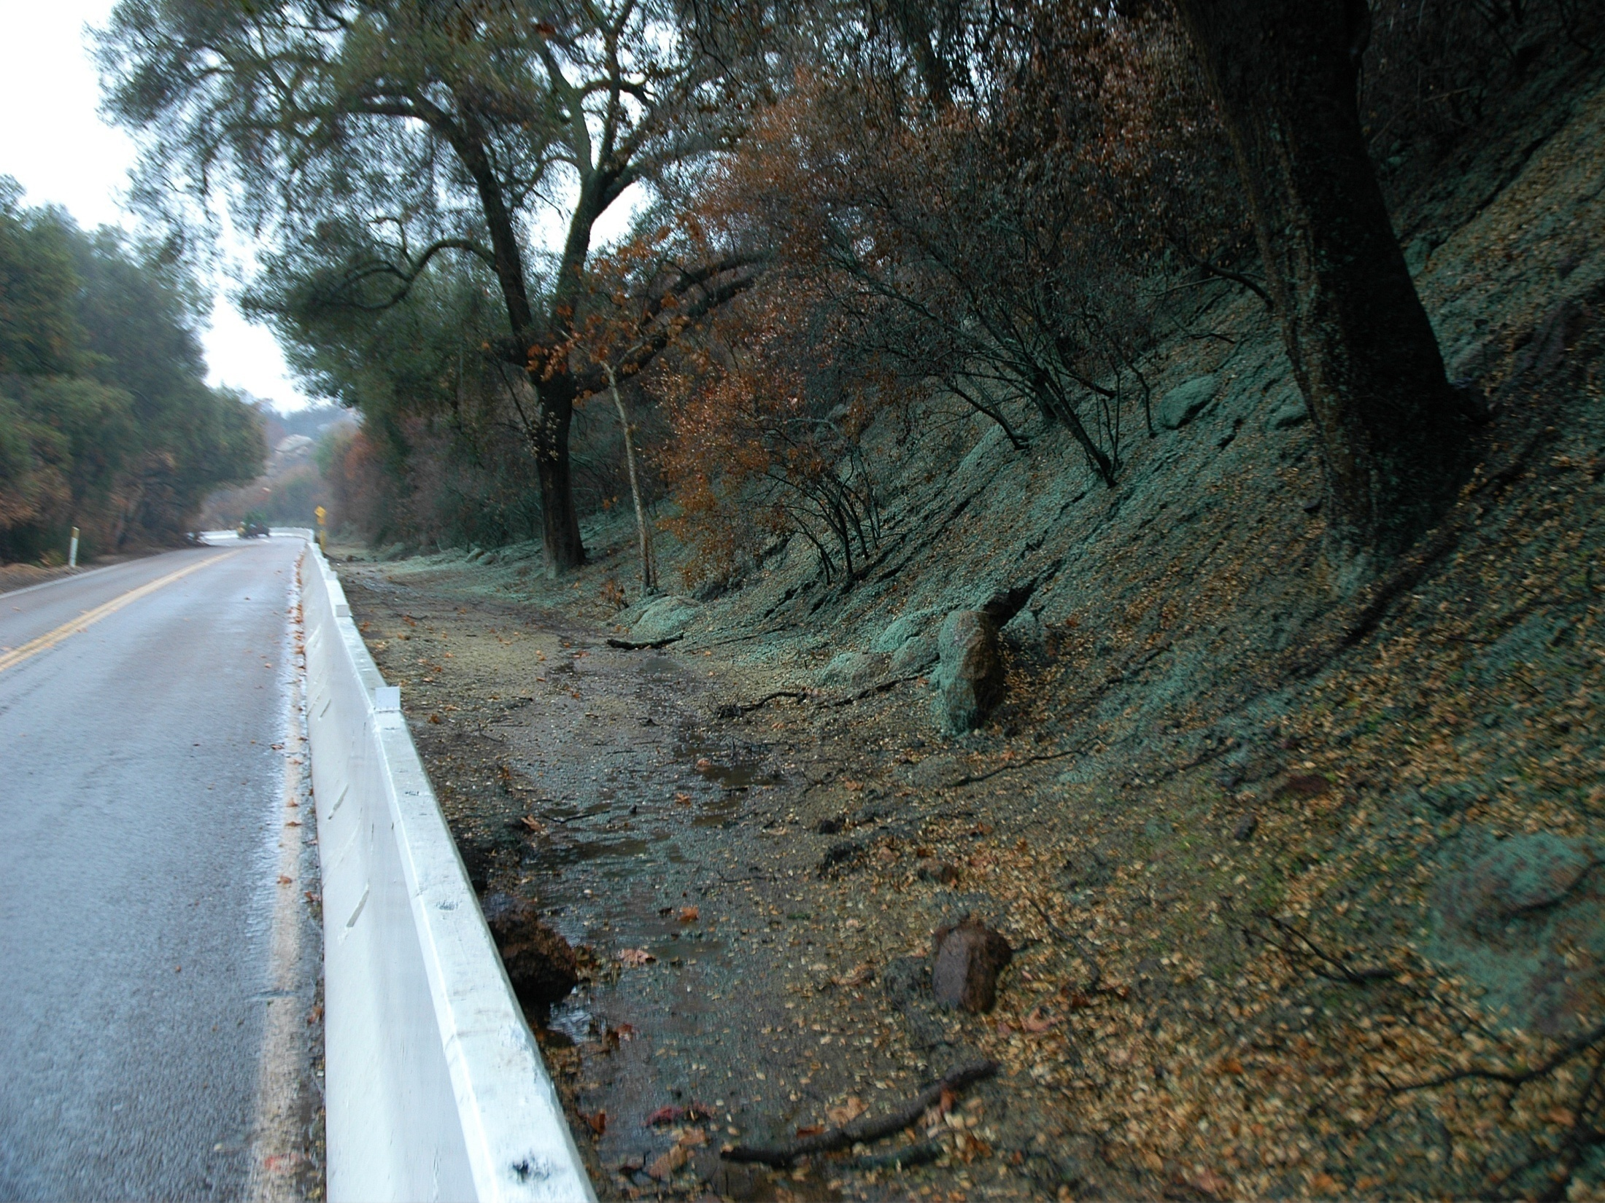
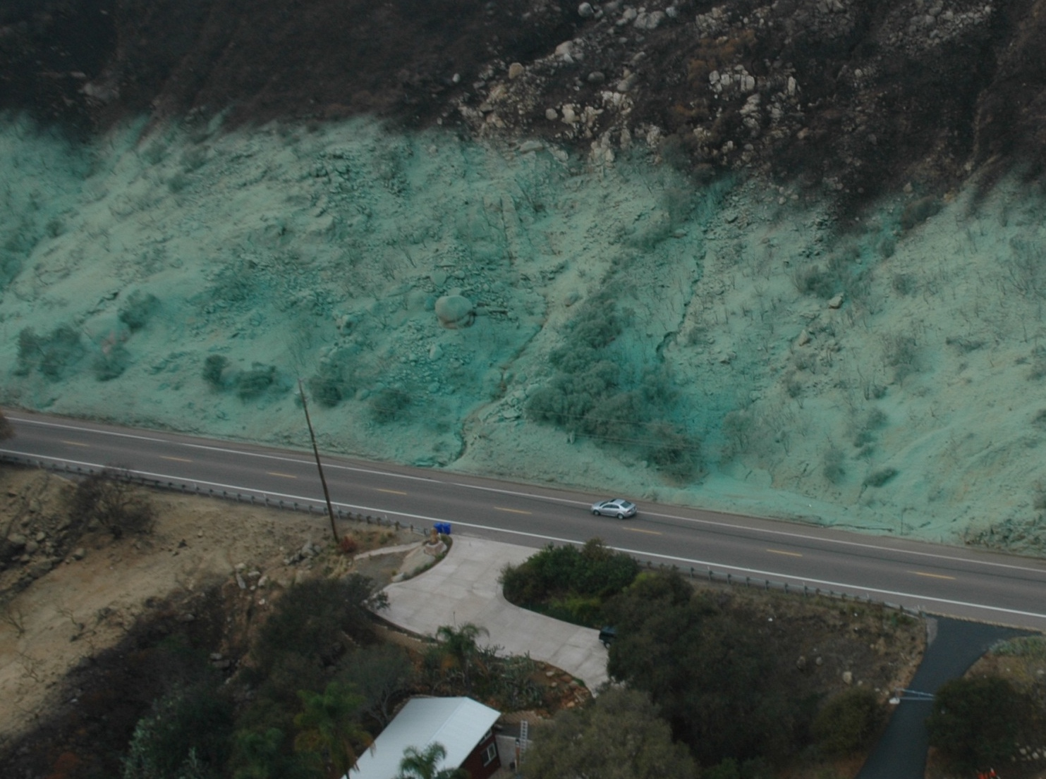
How high are the risks and what are the consequences?
POST-FIRE HAZARDS & VARs
MITIGATION
WARNING & EVACUATION
Increasing Risk

Slide 9
Assess risks to VARs
POST-FIRE HAZARDS & VARs
MITIGATION
WARNING & EVACUATION
Probability of Loss or Damage | Magnitude of Consequences
 | Major | Moderate | Minor
Very Likely | Very High Risk | Very High Risk | Low to Intermediate Risk
Likely | Very High Risk | High Risk | Low to Intermediate Risk
Possible | High Risk | Intermediate Risk | Low to Intermediate Risk
Unlikely | Intermediate Risk | Low to Intermediate Risk | Low Risk
Notes:
R

Slide 10
Debris retention – debris nets
POST-FIRE HAZARDS & VARs
MITIGATION
WARNING & EVACUATION
Source: https://www.geobrugg.com/

Slide 11
Warning & Evacuation

Slide 12
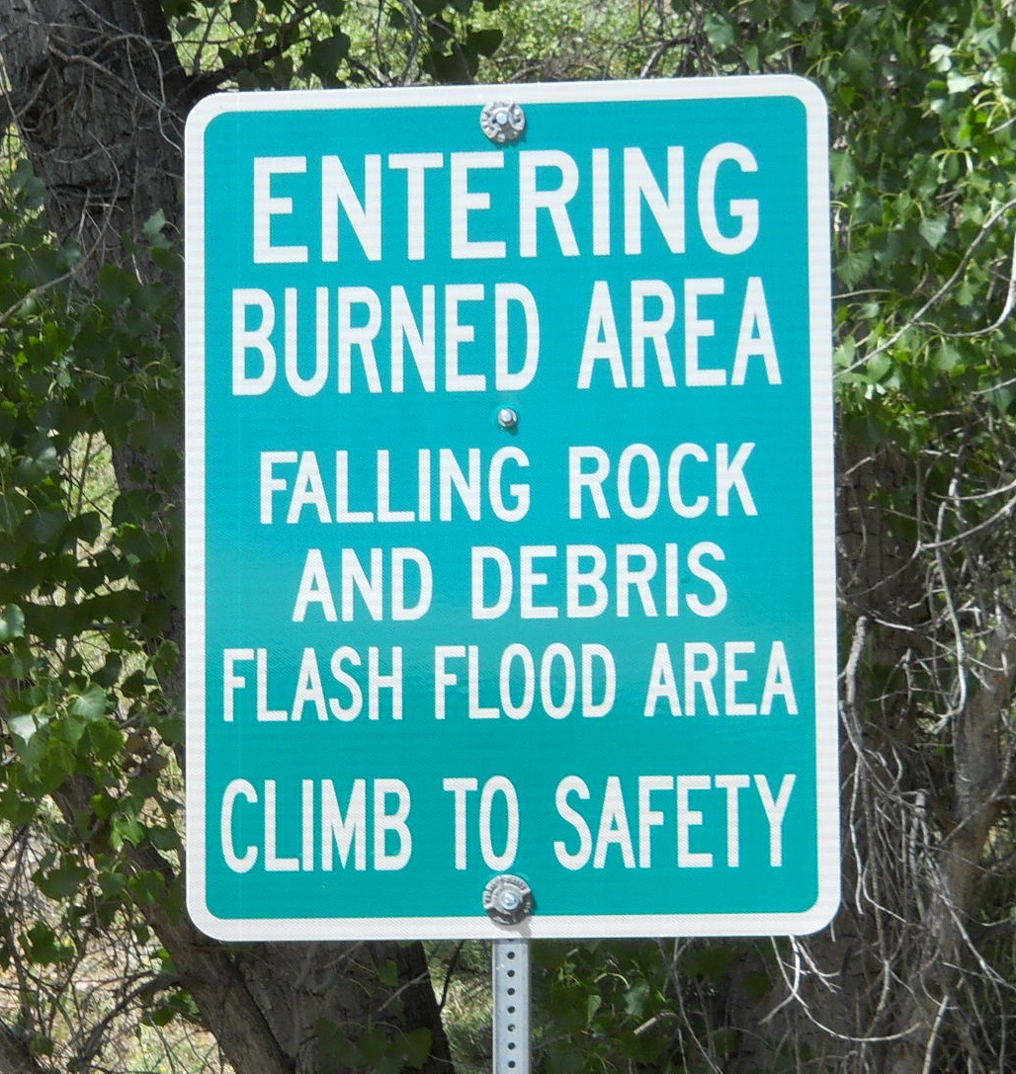
Install warning signs
POST-FIRE HAZARDS & VARs
MITIGATION
WARNING & EVACUATION

Slide 13
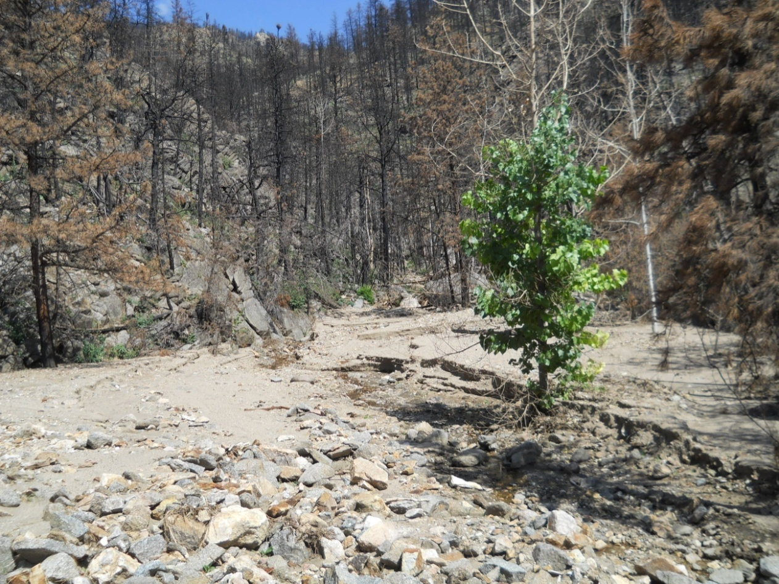
Determine thresholds for warning & evacuation
POST-FIRE HAZARDS & VARs
MITIGATION
WARNING & EVACUATION
Rules of thumb in Colorado:
0.25 inches of rain in 15-minutes on steep, severely burned slopes will generate runoff, mud, and debris
2-year rainfall event may trigger 10- to 100-year runoff response containing significant debris in severely burned watersheds

Slide 14
Resources for recovery - CWCB
https://www.coloradoewp.com/home

Slide 15
Questions, Answers, & Discussion
POST-FIRE HAZARDS & VARs
MITIGATION
WARNING & EVACUATION
Andrew Earles, Ph.D., P.E., CPESC & Natalie Collar, CFM, HIT, Wayne Lorenz, P.E.
Wright Water Engineers, Inc.
aearles@wrightwater.com
ncollar@wrightwater.com
wlorenz@wrightwater.com
(303) 480 1700

